Slide 1

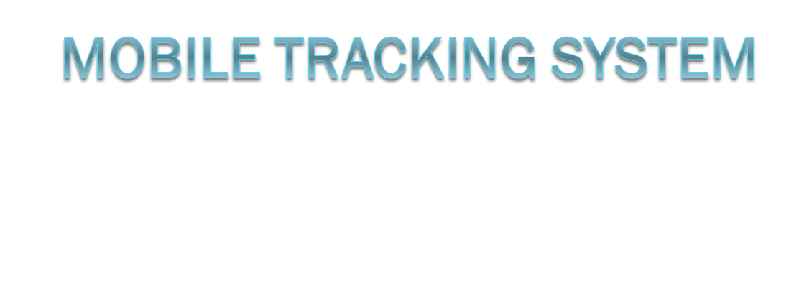
BY:
J.PADMINI
K.MOUNICA
K.RAVALI

Slide 2
Overview
Mobile Tracking System was first released in Romania in February 2007.
Currently MTS works with more then 170 GSM network operators from all around the world.
No advertising at all.
Built based on community’s suggestions and critics.

Slide 3
Availability: Platform
Android OS
Windows Mobile 2003/5/6
Symbian S60 3rd edition & UIQ
Java (limited functionality)
Windows PC

Slide 4
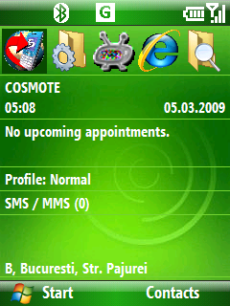
Features: Location Specific
Your current location is displayed on the phone’s home screen

Slide 5
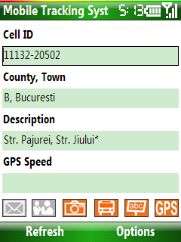
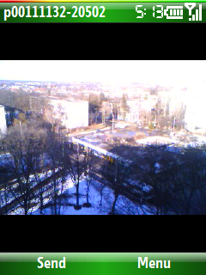
Features: Location Specific
You can view a picture of the current location if available (when the picture glyph turns orange)

Slide 6
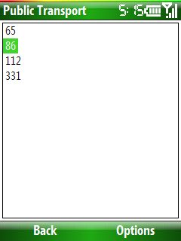
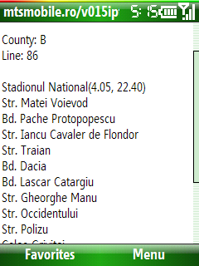
Features: Location Specific
You can view public transport information if available (when the bus glyph turns orange)

Slide 7
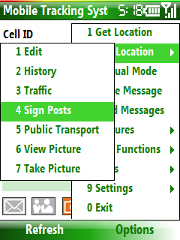
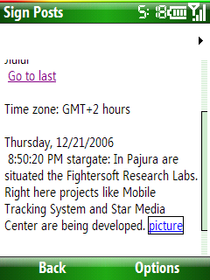
Features: Location Specific
You can view location forum (sign posts) if available (when the abc glyph turns orange)

Slide 8
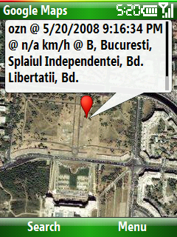
Features: Location Specific
You can see what other users are passing by through your current location
You can view your location on a map if the GPS glyph turns orange

Slide 9
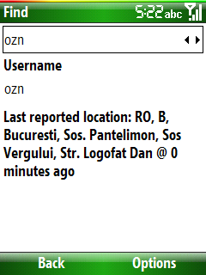
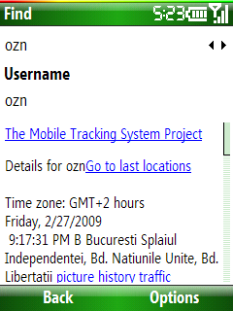
Features: User Specific
You can see where your friends are quickly or by reviewing a detailed report with the last 500 locations

Slide 10
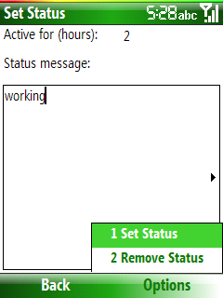
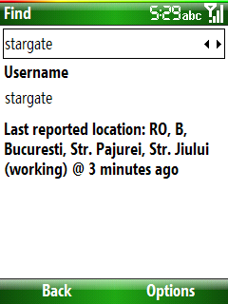
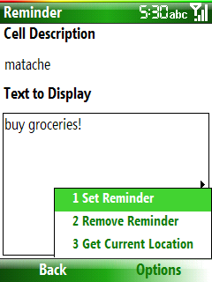
Features: User Specific
If a friend is nearby, the people glyph turns orange and you get an audio warning
You can set a status to let everybody know what you are doing where you are
You can set a location based reminder – when you reach a particular area a message will be displayed (this way you will never forget to buy groceries when returning home)

Slide 11

Features: User Specific
Place your updated location on websites, forums, e-mails and blogs

Slide 12
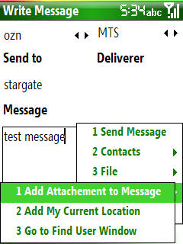
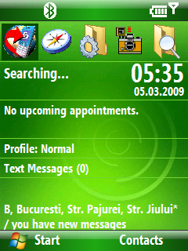
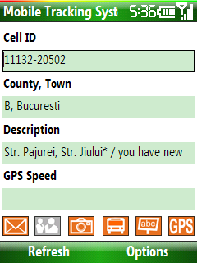
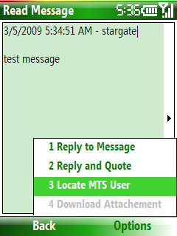
Features: Messaging
Send and receive text messages
Send and receive e-mail (push support)
Send and receive messages with attachments

Slide 13
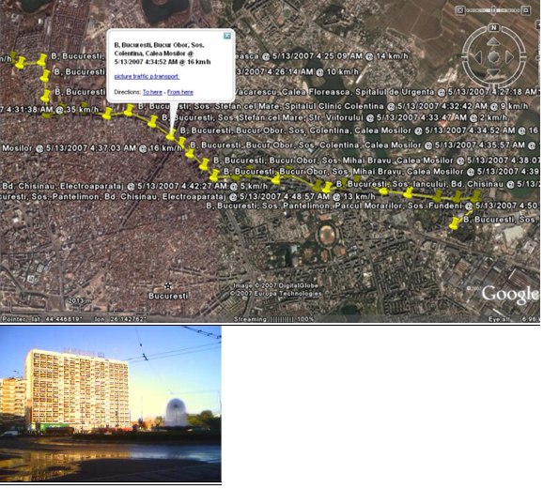
Features: Reporting
Detailed last 500 locations report

Slide 14
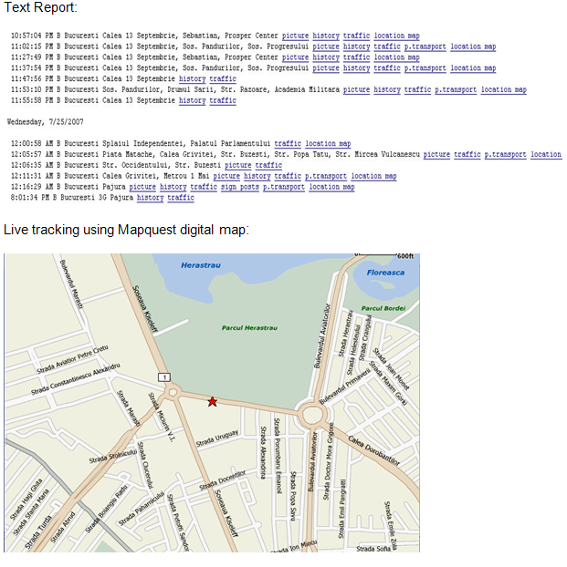
Features: Reporting

Slide 15
Applications
Social networking
Commercial messaging/location based software
Anti-theft
Support for 3rd party projects via MTS’s public API

Slide 16
Implementation
No integration with a GSM network is required (except for the database of cell ids – but this can be created by the social networking users)
Client/server architecture – only one machine required for user administration, advertising management, profiling, locations database and billing if required

